Slide 1
A Study of the Space Station Remote Manipulator System
Course Project
Mechanics of Robot Manipulators
MEEN 612
Dr. Pilwon Hur
By,
Rinda Sai Krishna Gunjala
Rohith Karthikeyan
Zongyao Jin

Slide 2
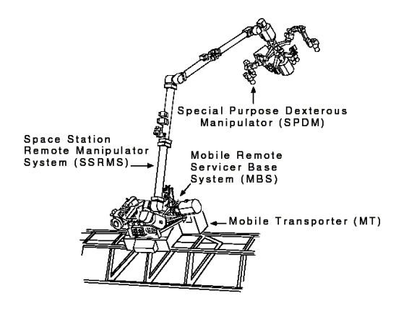
The SSRMS (Canadarm 2)
Redundant 7 DOF Manipulator
Aids with assembly, maintenance and docking.
Mimics inch-worm motion and can relocate across the Surface of the ISS
https://www.nasa.gov/centers/johnson/pdf/486042main_ISSRoboticsHumanFactorsPerspective.pdf

Slide 3
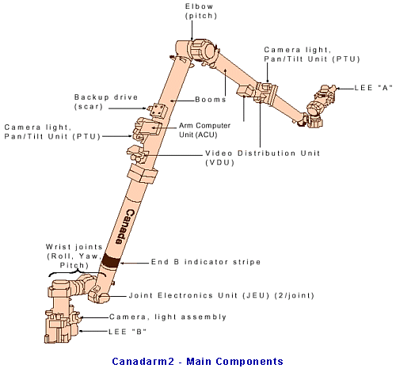
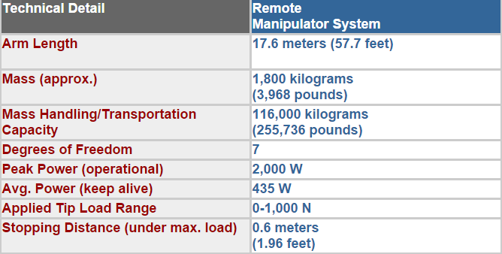
Objectives:
To understand the configuration of this system
Develop the equivalent DH model
Obtain the system dynamics
Implement a control algorithm robust to uncertainties
Understand the complexities of Space Robotics in general
*https://www.nasa.gov/centers/johnson/pdf/486042main_ISSRoboticsHumanFactorsPerspective.pdf

Slide 4
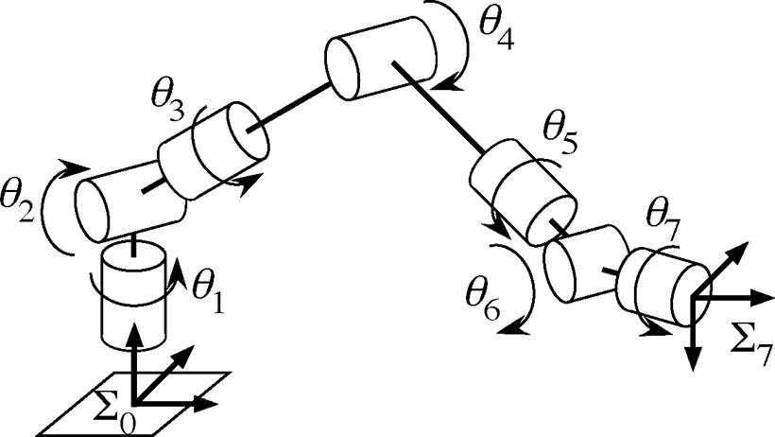
System Configuration
DH Convention
Frame Assignment
Wrist-Elbow-Wrist

Slide 5
The DH Table
Description | Link | Ɵ_{i} | d_{i} | a_{i} | α_{i}
Base-Grapple Holder | 1 | 90 | d1 | 0 | 90
Shoulder Link | 2 | 90 | d2 | 0 | 90
Upper Arm Boom | 3 | 0 | d3 | a3 | 0
Lower Arm Boom | 4 | 0 | 0 | a4 | 0
Wrist Link | 5 | 180 | 0 | 0 | 90
Wrist Link | 6 | -90 | d6 | 0 | 90
End Effector | 7 | 180 | d7 | 0 | 90

Slide 6
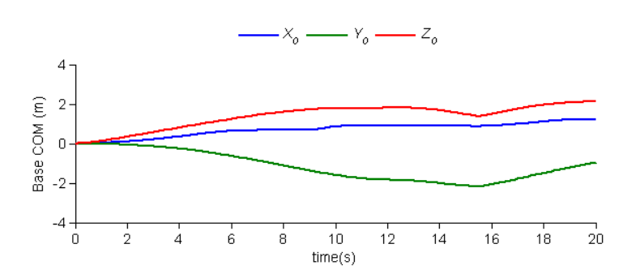
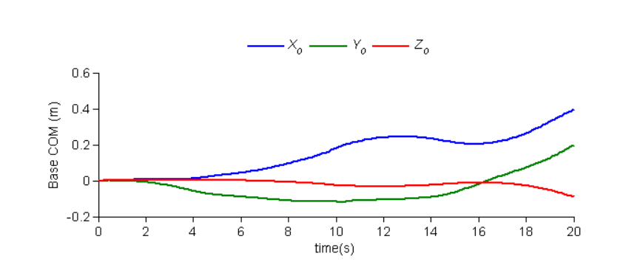
Recursive Dynamic Simulator
Floating Base COM Position
A Recursive solver package for obtaining the Dynamics of Robots and Multi-body systems.
Employed this tool to test the correctness of DH assumptions and arrive at simple simulations.
Also served to show the effect of end effector load on base system COM and the need for compensation.
The Satellite –Manipulator System constitutes a Free Floating Base and is modelled as such.
High Load Minimal Load

Slide 7
The Dynamically Equivalent Manipulator
The motion of the base must be compensated for.
This can be done by designing a Dynamically Equivalent Manipulator.
The DEM is a fixed base manipulator which simulates the behaviour of the original floating base manipulator.
The base frame of the DEM is situated at the CG of the original floating base system.
An additional passive, spherical joint is introduced in the DEM, which connects the first link to the DEM

Slide 8
3 DOF Planar RRR Example

Slide 9
Robot Dynamics
This was pretty complex, ultimately arrived at using Robotica on Mathematica.
The Input data suitably parameterized to allow room for uncertainty.
The Robot Dynamics were essential for testing the Control Law
The C, D and G Matrices were converted into a suitable (Simplified) format and interfaced with the control.
C, D 7x7 Matrices
G 7x1 Matrix
Certain simplifying assumptions made to reduce computation time.

Slide 10
Controls for 7 DOF & Animations for 2 DOF
PD + Inverse Dynamics
Robust Control
Dynamic Parameters (50% Uncertainty)
Control Parameters (Following VS Chattering)
Optimal Control
Control Every Part (Different penalty on each part)
Easy to Implement (Like PD, just need one ARE)
More Practical (Penalty on control input)
2 DOF Animation for Each Control Law

Slide 11
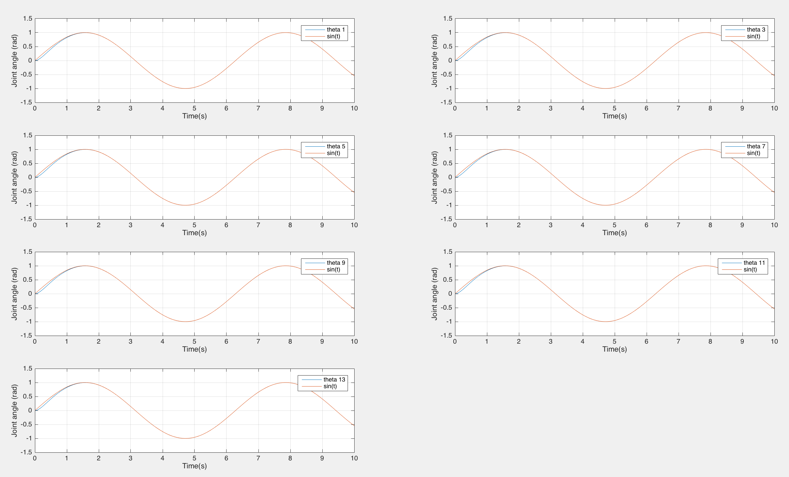
PD + Inverse: Perfect model

Slide 12
Robust Control: 50% Uncertainty
Case 1: Moderate Control Parameters
Doesn’t follow good enough
Perturbations on joint velocity
Less chattering

Slide 13
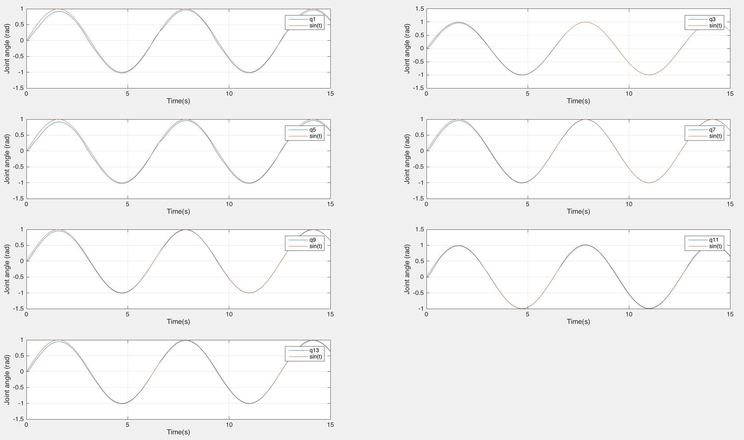

Slide 14
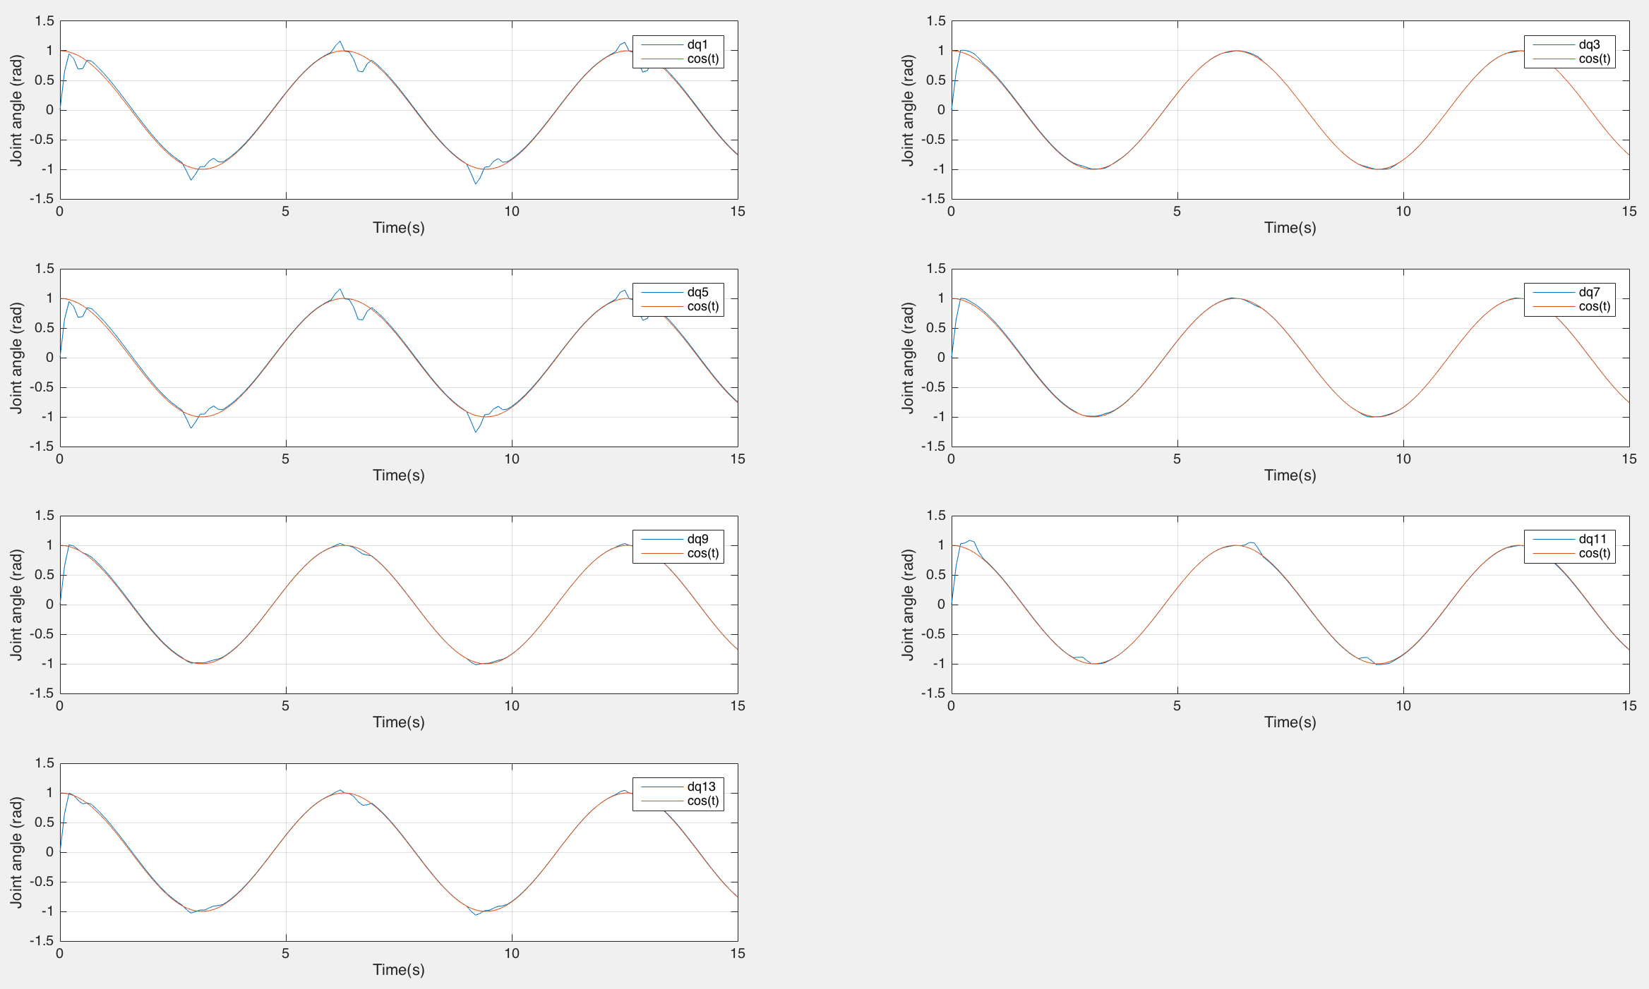

Slide 15
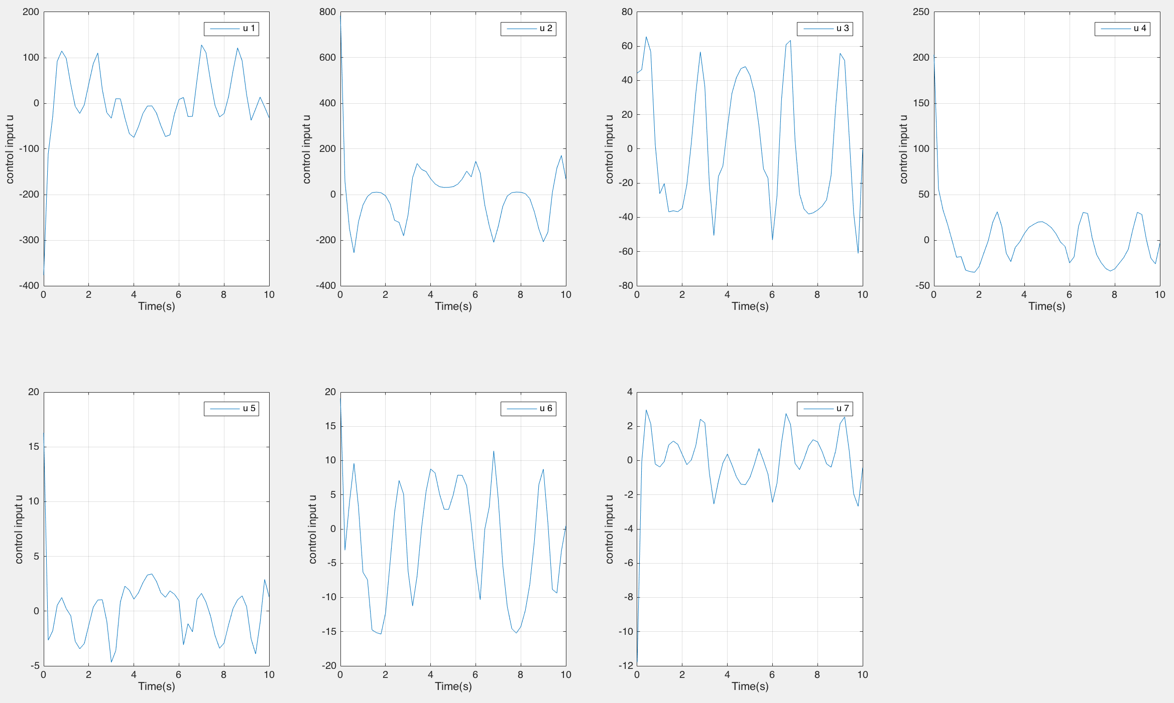

Slide 16
Robust Control: 50% Uncertainty
Case 2: Aggressive Control Parameters
Follows pretty well
Almost no perturbations on joint velocity
“Noisy”

Slide 17
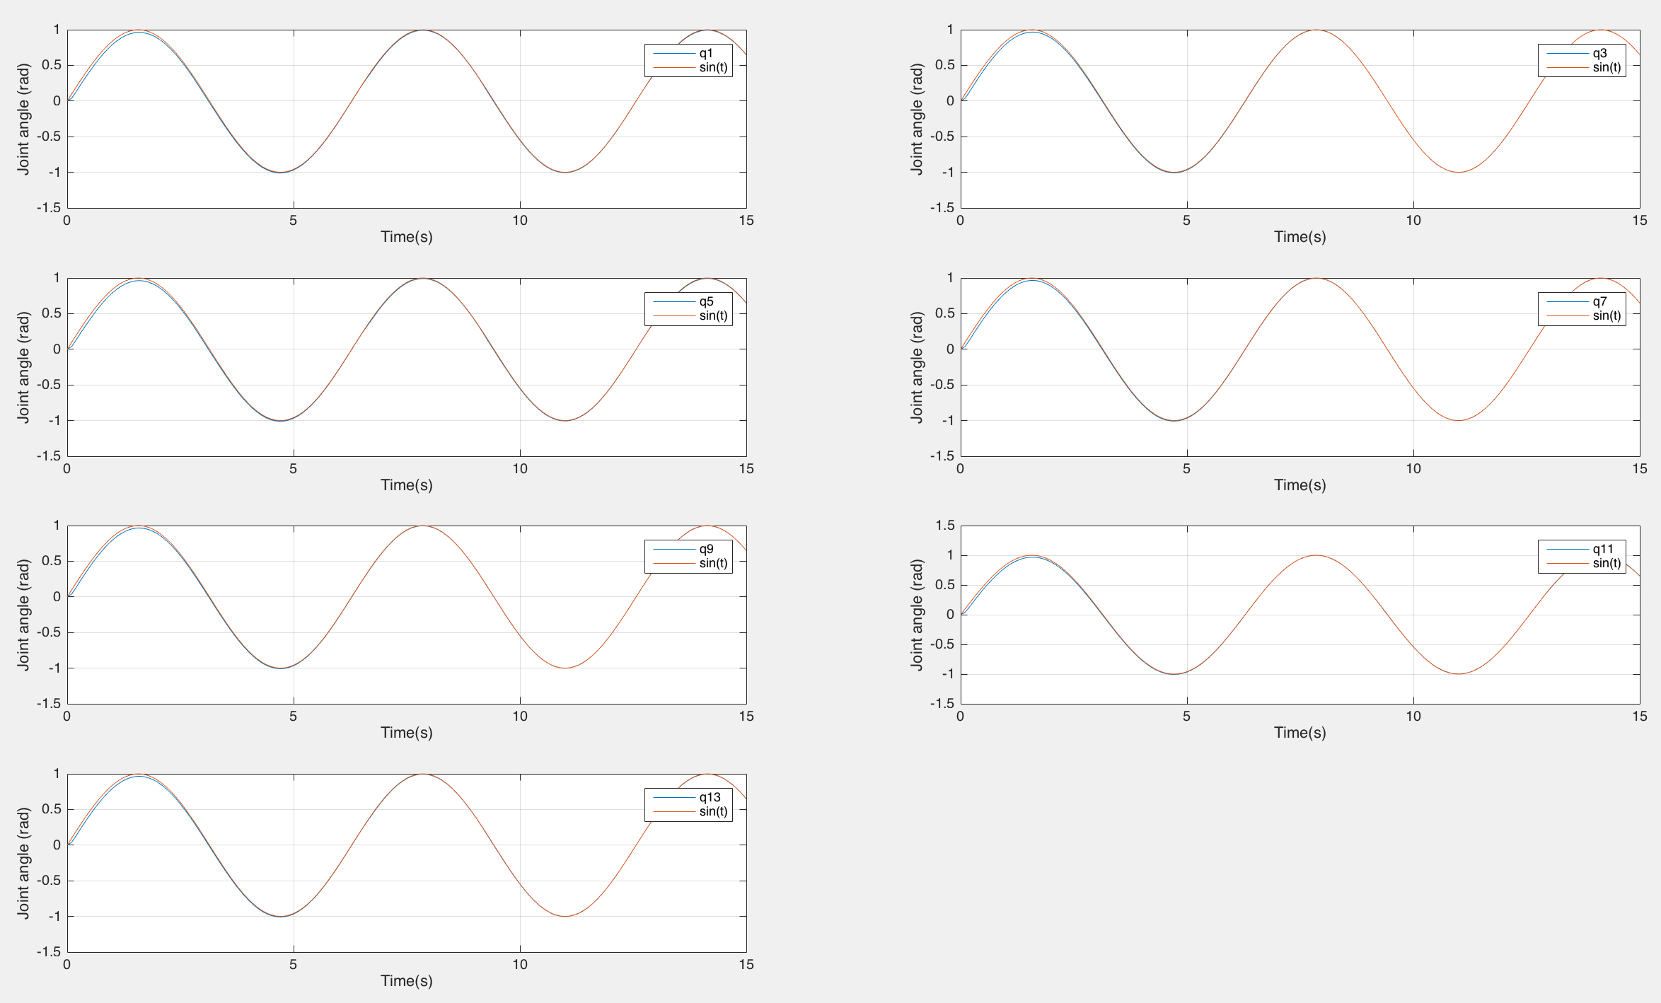

Slide 18
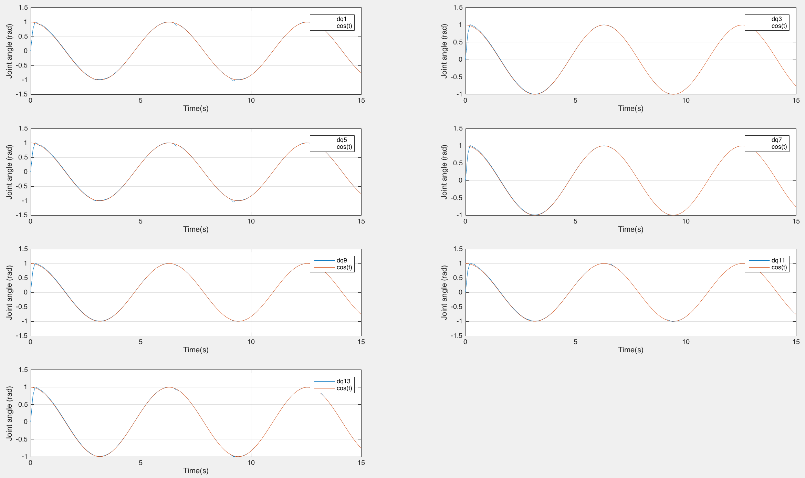

Slide 19
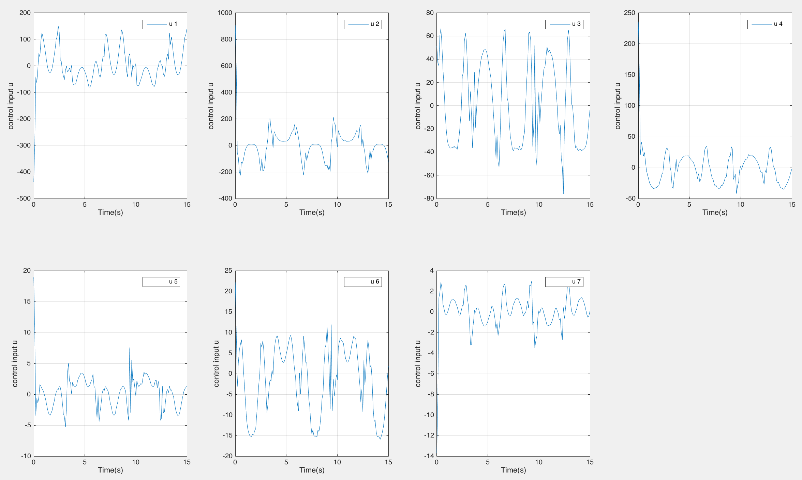

Slide 20
Optimal Control: “Control on Each Part”
Case 1: Same penalty on each joint and control input
Balance between tracking and control input

Slide 21
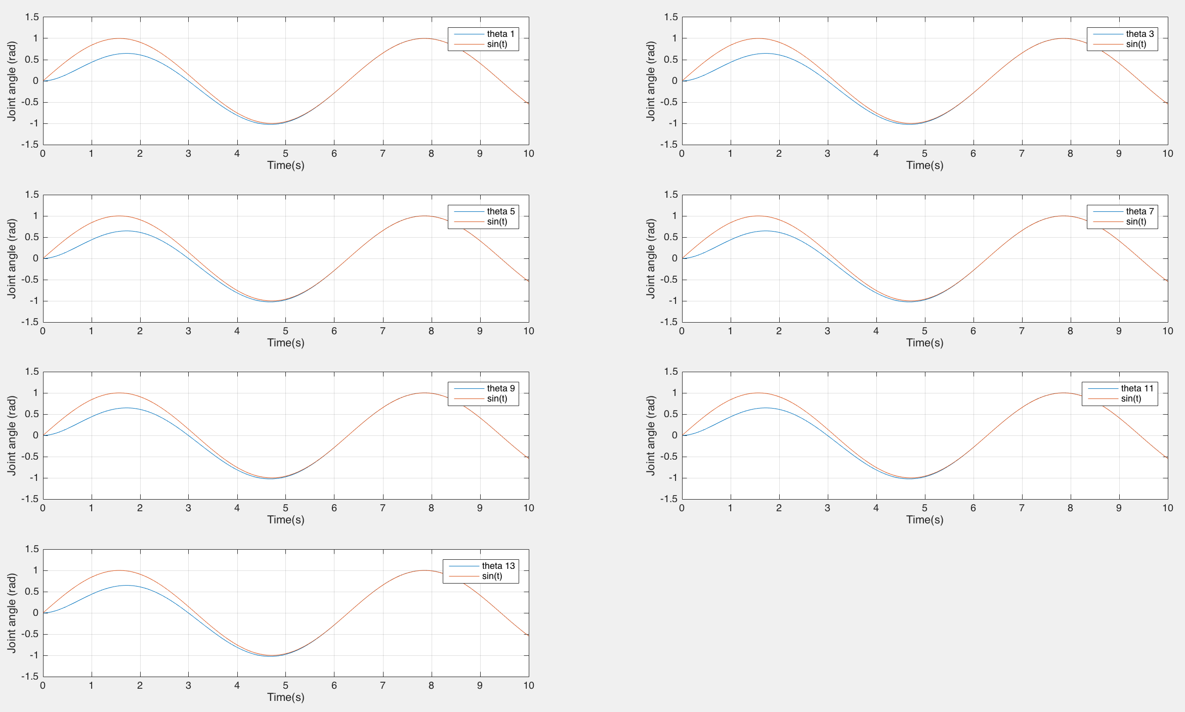

Slide 22
Optimal Control: “Control on Each Part”
Case 2: Small penalty control input
Tracking well, large control input needed

Slide 23
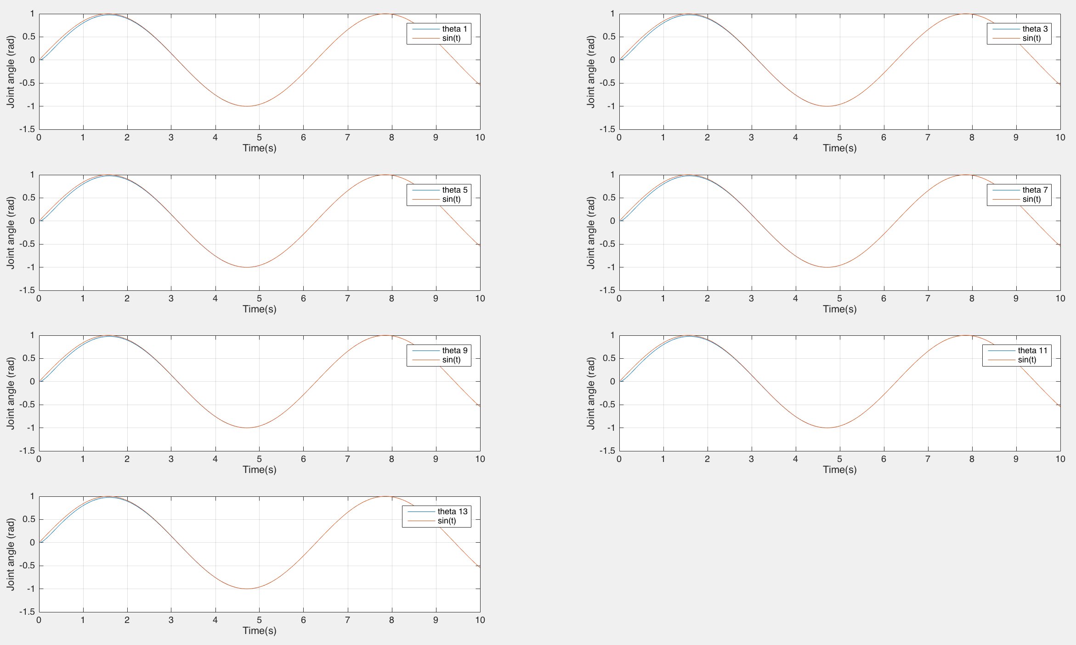

Slide 24
Optimal Control: “Control on Each Part”
Case 3: “Customized Control”
Power of Optimal Control & ARE
Penalty:
R = 0.1
Joint 2 = 0.01
Joint 4 = 0.001
Joint 6 = 0.1
Others: 1

Slide 25
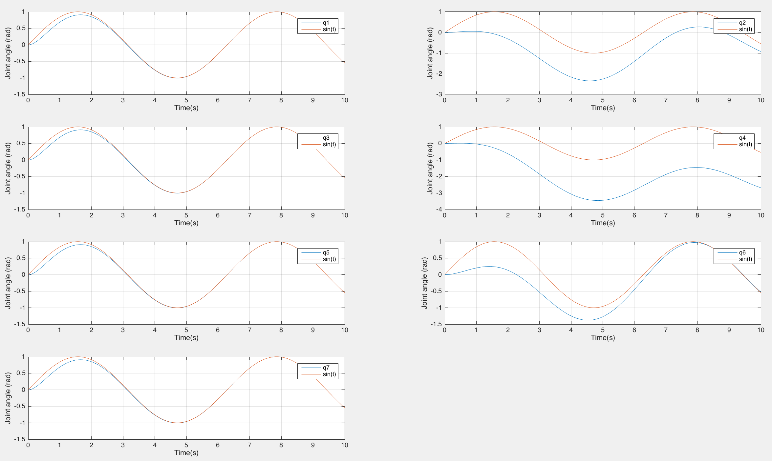

Slide 26
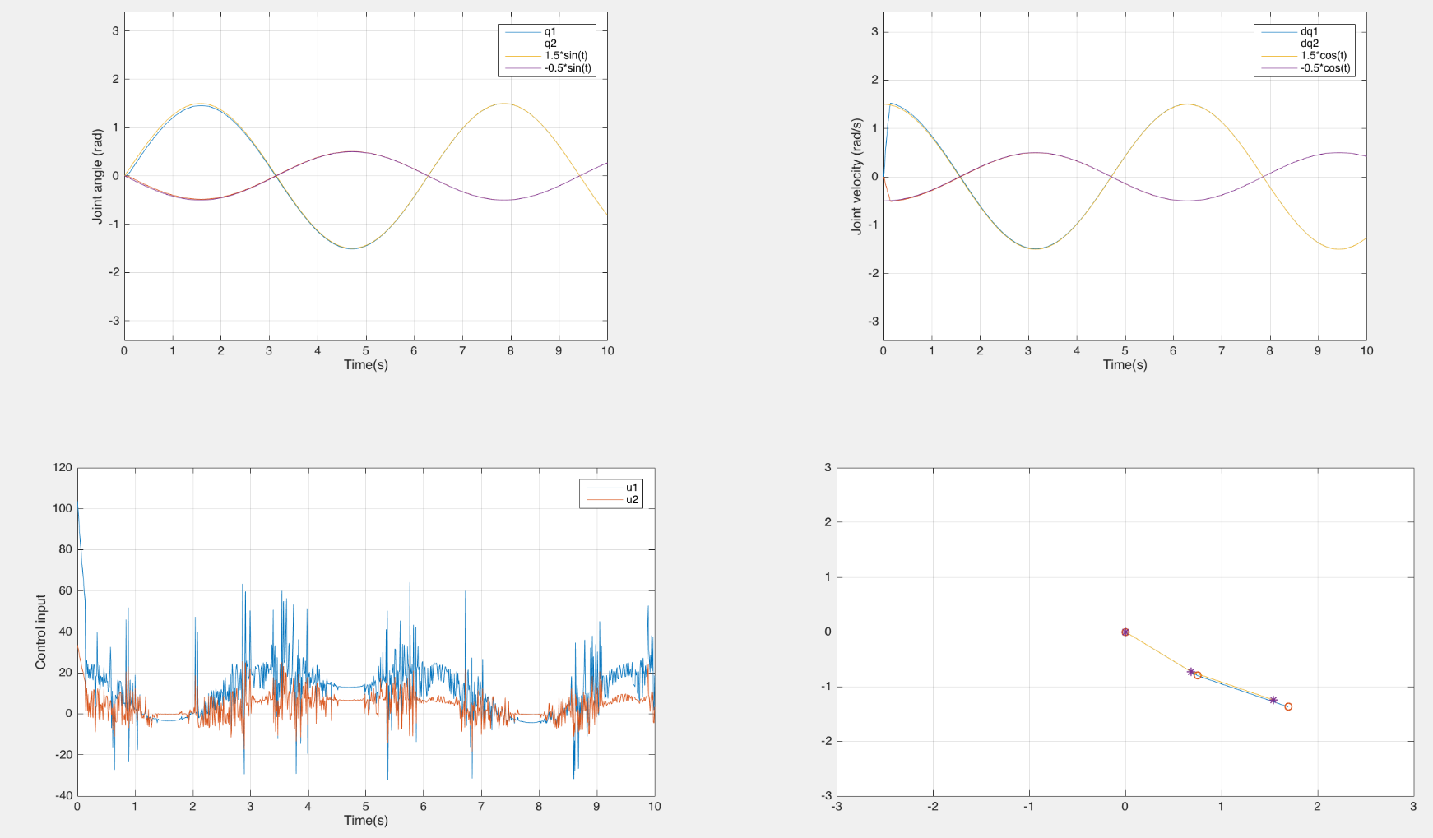
7 DOF Animation was complicated
Animations for 2 DOF and 7 DOF are available
Case: 10% Uncertainty (even length)
Case: Optimal (“customized” control)
And more

Slide 27
Thank You
Questions?

Slide 28
0.2375e1 .* a + 0.1625e1 .* b + 0.260831e2 .* m + (0.125e0 .* a + (-0.125e0) .* b + 0.664687e1 .* m) .* cos(2 .* q(2)) + 0.198375e1 .* m .* cos(2 .* (q(2) + (-1) .* q(3))) + (-0.39675e1) .* ...
m .* cos(2 .* q(3)) + 0.198375e1 .* m .* cos(2 .* (q(2) + q(3))) + ... 0.39675e1 .* m .* cos(2 .* q(2) + (-1) .* q(4)) + 0.39675e1 .* m .* ... cos(2 .* q(2) + (-2) .* q(3) + (-1) .* q(4)) + 0.198375e1 .* m .* cos(2 ... .* (q(2) + (-1) .* q(3) + (-1) .* q(4))) + 0.23805e2 .* m .* cos(q(4)) + ...
0.39675e1 .* m .* cos(2 .* q(2) + q(4)) + (-0.39675e1) .* m .* cos(2 ... .* (q(3) + q(4))) + 0.198375e1 .* m .* cos(2 .* (q(2) + q(3) + q(4))) + ( ... -0.7935e1) .* m .* cos(2 .* q(3) + q(4)) + 0.39675e1 .* m .* cos(2 .* ... q(2) + 2 .* q(3) + q(4)) + (-0.625e-1) .* a .* cos(2 .* (q(2) + (-1) .* ...
q(3) + (-1) .* q(4) + (-1) .* q(5))) + 0.625e-1 .* b .* cos(2 .* (q(2) + ( ... -1) .* q(3) + (-1) .* q(4) + (-1) .* q(5))) + 0.365625e-1 .* m .* cos(2 ... .* (q(2) + (-1) .* q(3) + (-1) .* q(4) + (-1) .* q(5))) + 0.2025e0 .* m .* ... cos(2 .* q(2) + (-1) .* q(3) + (-1) .* q(4) + (-1) .* q(5)) + (-0.27e0) ...
.* m .* cos(q(3) + q(4) + q(5)) + 0.125e0 .* a .* cos(2 .* (q(3) + q(4) + ... q(5))) + (-0.125e0) .* b .* cos(2 .* (q(3) + q(4) + q(5))) + (-0.73125e-1) ... .* m .* cos(2 .* (q(3) + q(4) + q(5))) + (-0.625e-1) .* a .* cos(2 .* ( ... q(2) + q(3) + q(4) + q(5))) + 0.625e-1 .* b .* cos(2 .* (q(2) + q(3) + q(4) + ...
q(5))) + 0.365625e-1 .* m .* cos(2 .* (q(2) + q(3) + q(4) + q(5))) + ( ... -0.2025e0) .* m .* cos(2 .* q(2) + q(3) + q(4) + q(5)) + (-0.125e0) .* a ... .* cos(2 .* q(2) + (-1) .* q(3) + (-1) .* q(4) + (-1) .* q(5) + (-2) .* ... q(6)) + 0.125e0 .* b .* cos(2 .* q(2) + (-1) .* q(3) + (-1) .* q(4) + (-1) ...
.* q(5) + (-2) .* q(6)) + (-0.10125e0) .* m .* cos(2 .* q(2) + (-1) .* ... q(3) + (-1) .* q(4) + (-1) .* q(5) + (-2) .* q(6)) + (-0.125e0) .* a .* ... cos(2 .* q(2) + q(3) + q(4) + q(5) + (-2) .* q(6)) + 0.125e0 .* b .* cos(2 ... .* q(2) + q(3) + q(4) + q(5) + (-2) .* q(6)) + (-0.10125e0) .* m .* cos(2 .* ... q(2) + q(3) + q(4) + q(5) + (-2) .* q(6)) + (-0.1875e0) .* a .* cos(2 .* ( ...
q(2) + (-1) .* q(6))) + 0.1875e0 .* b .* cos(2 .* (q(2) + (-1) .* q(6))) + ... (-0.151875e0) .* m .* cos(2 .* (q(2) + (-1) .* q(6))) + 0.405e0 .* m ... .* cos(2 .* q(2) + (-1) .* q(6)) + (-0.3375e-1) .* m .* cos(2 .* q(2) + ... (-2) .* q(3) + (-2) .* q(4) + (-2) .* q(5) + (-1) .* q(6)) + (-0.3125e-1) ... .* a .* cos(2 .* (q(2) + (-1) .* q(3) + (-1) .* q(4) + (-1) .* q(5) + (-1) ...
.* q(6))) + 0.3125e-1 .* b .* cos(2 .* (q(2) + (-1) .* q(3) + (-1) .* ... q(4) + (-1) .* q(5) + (-1) .* q(6))) + (-0.253125e-1) .* m .* cos(2 .* ( ... q(2) + (-1) .* q(3) + (-1) .* q(4) + (-1) .* q(5) + (-1) .* q(6))) + ... 0.135e0 .* m .* cos(2 .* q(2) + (-1) .* q(3) + (-1) .* q(4) + (-1) .* ... q(5) + (-1) .* q(6)) + 0.27e0 .* m .* cos(q(3) + q(4) + q(5) + (-1) .* q(6)) + ...
0.625e-1 .* a .* cos(2 .* (q(3) + q(4) + q(5) + (-1) .* q(6))) + ( ... -0.625e-1) .* b .* cos(2 .* (q(3) + q(4) + q(5) + (-1) .* q(6))) + ... 0.50625e-1 .* m .* cos(2 .* (q(3) + q(4) + q(5) + (-1) .* q(6))) + ( ... -0.3125e-1) .* a .* cos(2 .* (q(2) + q(3) + q(4) + q(5) + (-1) .* q(6))) + ...
0.3125e-1 .* b .* cos(2 .* (q(2) + q(3) + q(4) + q(5) + (-1) .* q(6))) + ( ... -0.253125e-1) .* m .* cos(2 .* (q(2) + q(3) + q(4) + q(5) + (-1) .* q(6))) + ... 0.27e0 .* m .* cos(2 .* q(2) + q(3) + q(4) + q(5) + (-1) .* q(6)) + ( ... -0.675e-1) .* m .* cos(2 .* q(3) + 2 .* q(4) + 2 .* q(5) + (-1) .* q(6)) + ...
0.3375e-1 .* m .* cos(2 .* q(2) + 2 .* q(3) + 2 .* q(4) + 2 .* q(5) + ( ... -1) .* q(6)) + (-0.81e0) .* m .* cos(q(6)) + (-0.125e0) .* a .* cos(2 ... .* q(6)) + 0.125e0 .* b .* cos(2 .* q(6)) + (-0.10125e0) .* m .* cos( ... 2 .* q(6)) + (-0.1875e0) .* a .* cos(2 .* (q(2) + q(6))) + 0.1875e0 .* ...
b .* cos(2 .* (q(2) + q(6))) + (-0.151875e0) .* m .* cos(2 .* (q(2) + ... q(6))) + 0.405e0 .* m .* cos(2 .* q(2) + q(6)) + 0.3375e-1 .* m .* cos( ... 2 .* q(2) + (-2) .* q(3) + (-2) .* q(4) + (-2) .* q(5) + q(6)) + ( ... -0.3125e-1) .* a .* cos(2 .* (q(2) + (-1) .* q(3) + (-1) .* q(4) + (-1) ...
.* q(5) + q(6))) + 0.3125e-1 .* b .* cos(2 .* (q(2) + (-1) .* q(3) + (-1) ... .* q(4) + (-1) .* q(5) + q(6))) + (-0.253125e-1) .* m .* cos(2 .* (q(2) + ... (-1) .* q(3) + (-1) .* q(4) + (-1) .* q(5) + q(6))) + (-0.27e0) .* m .* ... cos(2 .* q(2) + (-1) .* q(3) + (-1) .* q(4) + (-1) .* q(5) + q(6)) + ( ...
-0.27e0) .* m .* cos(q(3) + q(4) + q(5) + q(6)) + 0.625e-1 .* a .* cos(2 ... .* (q(3) + q(4) + q(5) + q(6))) + (-0.625e-1) .* b .* cos(2 .* (q(3) + q(4) + ... q(5) + q(6))) + 0.50625e-1 .* m .* cos(2 .* (q(3) + q(4) + q(5) + q(6))) + ( ... -0.3125e-1) .* a .* cos(2 .* (q(2) + q(3) + q(4) + q(5) + q(6))) + ...
0.3125e-1 .* b .* cos(2 .* (q(2) + q(3) + q(4) + q(5) + q(6))) + ( ... -0.253125e-1) .* m .* cos(2 .* (q(2) + q(3) + q(4) + q(5) + q(6))) + ( ... -0.135e0) .* m .* cos(2 .* q(2) + q(3) + q(4) + q(5) + q(6)) + 0.675e-1 .* ... m .* cos(2 .* q(3) + 2 .* q(4) + 2 .* q(5) + q(6)) + (-0.3375e-1) .* m .* ...
cos(2 .* q(2) + 2 .* q(3) + 2 .* q(4) + 2 .* q(5) + q(6)) + 0.125e0 .* a .* ... cos(2 .* q(2) + (-1) .* q(3) + (-1) .* q(4) + (-1) .* q(5) + 2 .* q(6)) + ( ... -0.125e0) .* b .* cos(2 .* q(2) + (-1) .* q(3) + (-1) .* q(4) + (-1) .* ... q(5) + 2 .* q(6)) + 0.10125e0 .* m .* cos(2 .* q(2) + (-1) .* q(3) + (-1) ...
.* q(4) + (-1) .* q(5) + 2 .* q(6)) + 0.125e0 .* a .* cos(2 .* q(2) + q(3) + ... q(4) + q(5) + 2 .* q(6)) + (-0.125e0) .* b .* cos(2 .* q(2) + q(3) + q(4) + ... q(5) + 2 .* q(6)) + 0.10125e0 .* m .* cos(2 .* q(2) + q(3) + q(4) + q(5) + 2 ... .* q(6)) + 0.3105e1 .* m .* sin(2 .* q(2) + (-1) .* q(3)) + 0.414e1 .* ...
m .* sin(q(3)) + 0.3105e1 .* m .* sin(2 .* q(2) + q(3)) + 0.3105e1 .* m ... .* sin(2 .* q(2) + (-1) .* q(3) + (-1) .* q(4)) + 0.414e1 .* m .* sin( ... q(3) + q(4)) + 0.3105e1 .* m .* sin(2 .* q(2) + q(3) + q(4)) + (-0.25875e0) ... .* m .* sin(2 .* q(2) + (-1) .* q(5)) + (-0.25875e0) .* m .* sin(2 .* ...
q(2) + (-2) .* q(3) + (-2) .* q(4) + (-1) .* q(5)) + (-0.25875e0) .* m .* ... sin(2 .* q(2) + (-1) .* q(4) + (-1) .* q(5)) + (-0.25875e0) .* m .* sin( ... 2 .* q(2) + (-2) .* q(3) + (-1) .* q(4) + (-1) .* q(5)) + 0.15525e1 .* m ... .* sin(q(5)) + 0.25875e0 .* m .* sin(2 .* q(2) + q(5)) + 0.15525e1 .* m ...
.* sin(q(4) + q(5)) + 0.25875e0 .* m .* sin(2 .* q(2) + q(4) + q(5)) + ( ... -0.5175e0) .* m .* sin(2 .* q(3) + q(4) + q(5)) + 0.25875e0 .* m .* sin( ... 2 .* q(2) + 2 .* q(3) + q(4) + q(5)) + (-0.5175e0) .* m .* sin(2 .* q(3) + ... 2 .* q(4) + q(5)) + 0.25875e0 .* m .* sin(2 .* q(2) + 2 .* q(3) + 2 .* q(4) ...
+ q(5)) + (-0.5175e0) .* m .* sin(2 .* q(2) + (-1) .* q(3) + (-1) .* q(6)) ... + (-0.5175e0) .* m .* sin(2 .* q(2) + q(3) + (-1) .* q(6)) + ( ... -0.5175e0) .* m .* sin(2 .* q(2) + (-1) .* q(3) + (-1) .* q(4) + (-1) .* ... q(6)) + (-0.5175e0) .* m .* sin(2 .* q(2) + q(3) + q(4) + (-1) .* q(6)) + ( ...
-0.25875e0) .* m .* sin(2 .* q(2) + (-1) .* q(5) + (-1) .* q(6)) + ( ... -0.25875e0) .* m .* sin(2 .* q(2) + (-2) .* q(3) + (-2) .* q(4) + (-1) ... .* q(5) + (-1) .* q(6)) + (-0.25875e0) .* m .* sin(2 .* q(2) + (-1) .* ... q(4) + (-1) .* q(5) + (-1) .* q(6)) + (-0.25875e0) .* m .* sin(2 .* q(2) + ...
(-2) .* q(3) + (-1) .* q(4) + (-1) .* q(5) + (-1) .* q(6)) + (-0.15525e1) ... .* m .* sin(q(5) + (-1) .* q(6)) + (-0.25875e0) .* m .* sin(2 .* q(2) + ... q(5) + (-1) .* q(6)) + (-0.15525e1) .* m .* sin(q(4) + q(5) + (-1) .* q(6)) ... + (-0.25875e0) .* m .* sin(2 .* q(2) + q(4) + q(5) + (-1) .* q(6)) + ...
0.5175e0 .* m .* sin(2 .* q(3) + q(4) + q(5) + (-1) .* q(6)) + ( ... -0.25875e0) .* m .* sin(2 .* q(2) + 2 .* q(3) + q(4) + q(5) + (-1) .* q(6)) ... + 0.5175e0 .* m .* sin(2 .* q(3) + 2 .* q(4) + q(5) + (-1) .* q(6)) + ( ... -0.25875e0) .* m .* sin(2 .* q(2) + 2 .* q(3) + 2 .* q(4) + q(5) + (-1) .* ...
q(6)) + (-0.5175e0) .* m .* sin(2 .* q(2) + (-1) .* q(3) + q(6)) + ( ... -0.5175e0) .* m .* sin(2 .* q(2) + q(3) + q(6)) + (-0.5175e0) .* m .* ... sin(2 .* q(2) + (-1) .* q(3) + (-1) .* q(4) + q(6)) + (-0.5175e0) .* m .* ... sin(2 .* q(2) + q(3) + q(4) + q(6)) + 0.25875e0 .* m .* sin(2 .* q(2) + (-1) ...
.* q(5) + q(6)) + 0.25875e0 .* m .* sin(2 .* q(2) + (-2) .* q(3) + (-2) ... .* q(4) + (-1) .* q(5) + q(6)) + 0.25875e0 .* m .* sin(2 .* q(2) + (-1) .* ... q(4) + (-1) .* q(5) + q(6)) + 0.25875e0 .* m .* sin(2 .* q(2) + (-2) .* ... q(3) + (-1) .* q(4) + (-1) .* q(5) + q(6)) + 0.15525e1 .* m .* sin(q(5) + ...
q(6)) + 0.25875e0 .* m .* sin(2 .* q(2) + q(5) + q(6)) + 0.15525e1 .* m .* ... sin(q(4) + q(5) + q(6)) + 0.25875e0 .* m .* sin(2 .* q(2) + q(4) + q(5) + q(6)) ... + (-0.5175e0) .* m .* sin(2 .* q(3) + q(4) + q(5) + q(6)) + 0.25875e0 .* ... m .* sin(2 .* q(2) + 2 .* q(3) + q(4) + q(5) + q(6)) + (-0.5175e0) .* m .* ...
sin(2 .* q(3) + 2 .* q(4) + q(5) + q(6)) + 0.25875e0 .* m .* sin(2 .* q(2) + ... 2 .* q(3) + 2 .* q(4) + q(5) + q(6))

